Slide 1
Week 8 Live Session
Wendy Christensen, Ph.D. - COMP 4442

Slide 2
Agenda
Course logistics
Problem Set 7 questions
Ridge and Lasso review (finish)
Poisson regression
Problem Set 8 review

Slide 3
Upcoming deadlines (all 11:59 p.m. MDT)
Week 7 Participation: Due Sunday, 5/216 (past due)
Problem Set 7: Due 5/21 (this Friday)
Assigned today: Problem Set 8, due 5/28 (next Friday) - last one!
Participation Week 8: Due 5/23 (this Sunday)
I’m still working on Problem Sets 5 and 6, but those will be done soon.

Slide 4
Extra credit opportunity update
I mentioned earlier in the term that you can complete Methods Moments to earn up to +5 points to either your midterm or final exam, whichever score was lower.
There are be three opportunities to earn the +5 extra credit:
Methods Moment 1 - The Basics of Power
Methods Moment 2 - The Basics of Sampling
Methods Moment 3 - Ethics in Data Science

Slide 5
Extra credit opportunity amendment
If you satisfactorily complete any one of these, you will earn +2 points of extra credit.
If you satisfactorily complete any two of these, you will earn the full +5 points.
For the Power and Sampling Methods Moments, you will need to review the reading/s and then attempt to answer the questions. The questions are a mix of short answer and multiple choice, all of which have answers that come from the reading (although many answers could be obtained from other sources on the same subject).

Slide 6

Methods Moments: Power and Sampling
Download the zip file from the Files tab. Read the instructions first! It may be helpful to have the Google Form open as you complete the reading/s.

Slide 7
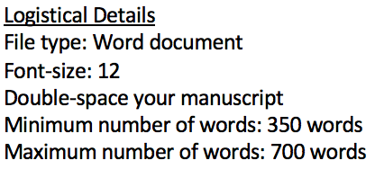
Methods Moment: Ethics in Data Science
Unlike the other two Methods Moments, this one will entail writing a short paper

Slide 8
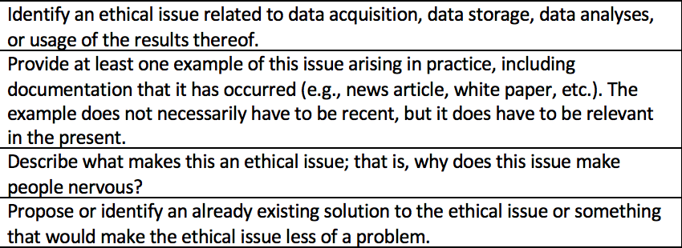
Methods Moment: Ethics in Data Science

Slide 9
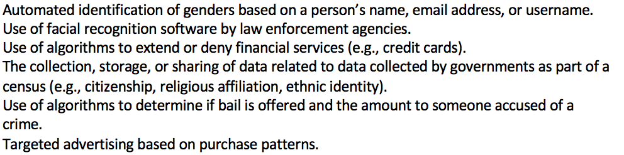
Methods Moment: Ethics in Data Science
There are many possible topics for the ethics response paper. Here were some that immediately came to my mind while writing the rubric:

Slide 10
Problem Set 7 questions?

Slide 11
Ridge and Lasso discussion

Slide 12
Lambda in ridge and lasso questions
In your groups, discuss the following about the lambda term in ridge vs lasso:
What is the potential range of lambda?
What is true about ridge vs lasso regression when lambda = 0?
As lambda gets bigger, what happens to the coefficients? How does this differ between ridge and lasso?
What is meant by “sets of coefficients” associated with lambda?

Slide 13
glmnet package questions
The glmnet() function in the glmnet package can fit both lasso and ridge regression models. Which one does the function perform by default? What change do you need to make if you want to perform the non-default option?
The first argument in the function is ‘x’. What should you put here and what form does it need to be in?
The second argument in the function is ‘y’. What should you put here and what form does it need to be in?
The third argument in the function is ‘family’. What is the default of this? When would you need to change it?
By default, how many sets of coefficients will be evaluated? What change would you need to make if you wanted to evaluate 500 lambdas?

Slide 14
Ridge vs Lasso: Question for the group
When comparing ridge vs lasso, what sort of situation would ridge perform better than lasso? When would lasso perform better than ridge?

Slide 15
Ridge vs Lasso: Question for the group
When comparing ridge vs lasso, what sort of situation would ridge perform better than lasso? When would lasso perform better than ridge?
Per the Elements of Statistical Learning text, lasso generally performs better when there are a small number of predictors that have high true coefficient values (i.e., many predictors contribute little to accounting for variability in the outcome and could be reasonably dropped). Ridge performs better when there are many predictors with about the same true coefficient values (i.e, all or most predictors contribute similarly and multicollinearity is likely) .

Slide 16
Poisson regression

Slide 17
Modeling counts as outcomes
The motivation for logistic regression is that binary outcomes aren’t modeled well by multiple linear regression because the data inherently violate the assumptions of regression (e.g., distribution of the residuals cannot be normally distributed for a binary outcome). Instead, we use logistic regression, which is in the family of generalized linear models, to model data with binary outcomes.
The motivation for Poisson regression is similar, but instead of modeling binary outcomes, the outcomes are counts. Counts are things like number of cigarettes smoked during a party, number of aggressive acts by children during a particular recess, number of calls received by a retail store on a certain day, etc.

Slide 18
Properties of counts that are bad for MLR
Counts have several properties that often make them bad candidates for MLR:
There are likely to be a lot of zeros - no cigarettes smoked, no aggressive acts, no calls to the store.
Counts are non-negative integers, but regression can return negative predicted values (which will always be bad predictions of counts).
Variance of counts often increases as the mean increases (e.g., when the mean is 3, the variance might be 1-6; when the mean is 20, the variance might be 10-30). Thus, meeting the equality of residual variance assumption is unlikely.

Slide 19
Poisson regression
Because of this, modeling count outcomes using MLR can result in Type 1 error inflation; the estimates of the coefficient standard errors are smaller than they actually are, making an incorrect rejection of the null hypotheses more likely than we would expect.
The Poisson distribution is useful for modeling count outcomes. The mean of the distribution (i.e., the expected count, sometimes also referred to as the rate parameter) is equal to the variance, meaning that the variance increases as the mean does. This property of the Poisson distribution reflects the third property of counts discussed earlier (variance increases as count increases).

Slide 20
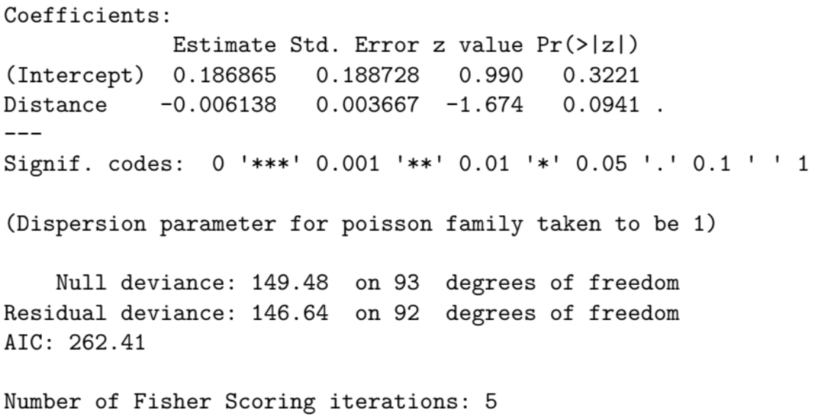
Interpreting the Poisson regression model
This output is from the async material. The outcome is the number of diagnosed cancer cases in a region.
The “gist” interpretation used for logistic regression also works here: As distance increases, the predicted number of cancer cases decreases.
The p-value for the distance predictor is not significant.

Slide 21
Overdispersion
If there is more variation in the residuals across predicted rates (i.e. expected counts) than allowed by the Poisson distribution, a condition called “overdispersion” has occurred. Once again, the result is Type 1 error rate inflation (via too-small standard error estimates).
You can loosen the restrictions of the Poisson model to reduce overdispersion. Two are covered in the async: the quasipoisson model and the negative binomial model.

Slide 22
Discussion
Review the async material 8.2.1 and answer the following questions:
How does quasipoisson regression loosen the distributional assumption of the model residuals in the Poisson model? How does the negative binomial model do so?
Comparing the Poisson regression model with the quasipoisson regression model, are the coefficient estimates noticeably different? What about the standard errors?
Where in the output would you look to see if there is evidence of overdispersion in the Poisson regression model? How could you evaluate if the quasipossion model or the negative binomial model improve it?

